Slide 1
Training on wheelchair provision and use in the curricula of rehabilitation professionals

Slide 2
Agenda
WHO Overview of WSTP and Integration (Chapal Khasnabis)
ISWP Overview & Meeting Goals (Jon Pearlman)
Integration Survey (Nicky Seymour)
Integration Interviews (Paula Rushton)
Integration Pilot Sites (Krithika Kandavel)
Case Study 1- Univ. CES, Colombia (Maria Toro)
Case Study 2 - Univ. of Montreal, Canada (Paula Rushton)
Discussions

Slide 3
Meeting Goals
Share outcomes of our research
Share activities related to integration
Learn about steps/ways to amplify integration activities.
Who are key decision makers related to curriculum
Continuing education vs. core curricula
Challenges/Opportunities related to funding & implementation
Next steps

Slide 4
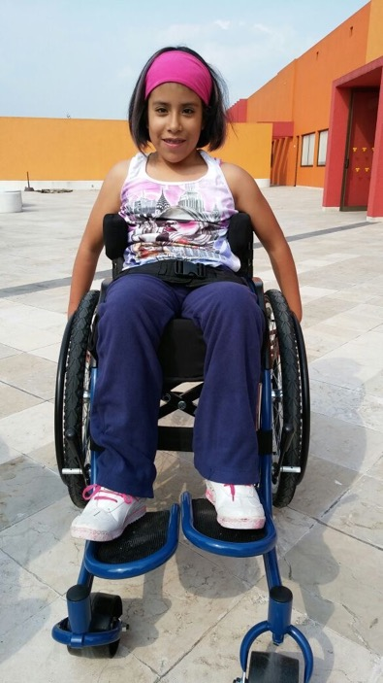
ISWP’s Overview
Mission: Serve as a global resource for wheelchair service standards and provision through advocacy, training/testing, standards, evidence-based practice, innovation and a platform for information exchange
Activities:
Awareness & Advocacy
Training
Product Quality Standards
Evidence-based practice

Slide 5
Working Groups
Advocacy
Training
Standards
Research
Increase awareness
Testing
Caster Failures
Data Collection
Increase policy adoption
Integration
Rolling Resistance
Minimum Data Set
Scalable Trainings
Design Guidelines
Research Framework

Slide 6
Integration
Goal: Increase number of trained WC service providers through training in OT/PT/O&P programs
Rationale:
These professionals often become WC service providers.
Training materials are already available.
There is a grass-root effort to add this curricula.
Current exposure is not enough, even at the basic level.

Slide 7
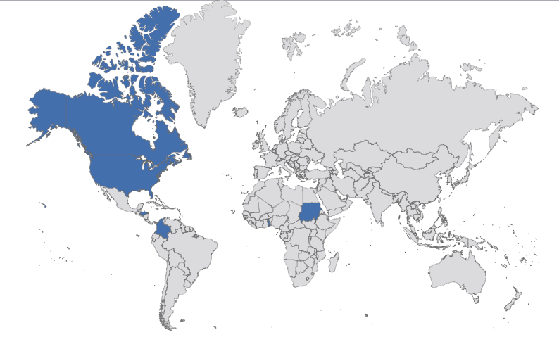
Survey Outcome
Very little exposure to WCs in core curricula
Strong desire for this training around the world
Some early-adopters demonstrating success

Slide 8
Current Activities
Facilitate meetings to share experiences
Supporting programs by providing tests & materials
Facilitating content sharing

Slide 9
A Global Description of Wheelchair Service Education
1. Cross-Sectional Survey Study
2. In-Depth Qualitative Interview Study
3. Integration Pilot Sites

Slide 10
Aim
To gain an enhanced understanding of the wheelchair service education provided in educational programs of rehabilitation professionals.

Slide 11
Methodology
Global survey: set of 27 questions

Slide 12
Participants 72 Establishments: 21 Countries
Physiotherapists 15
Occupational therapists 54
Prosthetist orthotists 11
Wheelchair service professionals 15

Slide 13
79% of curriculums included WC content
LRS 6
UMRS 6
HRS 31
LRS 3
UMRS 3
HRS 1

Slide 14
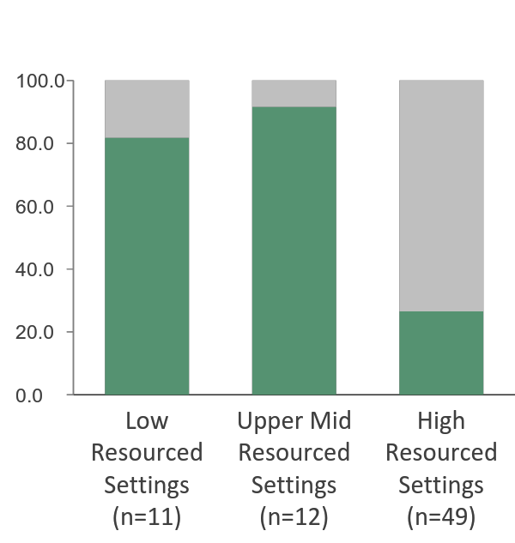
51% are unaware that WSTP exists
% aware

Slide 15
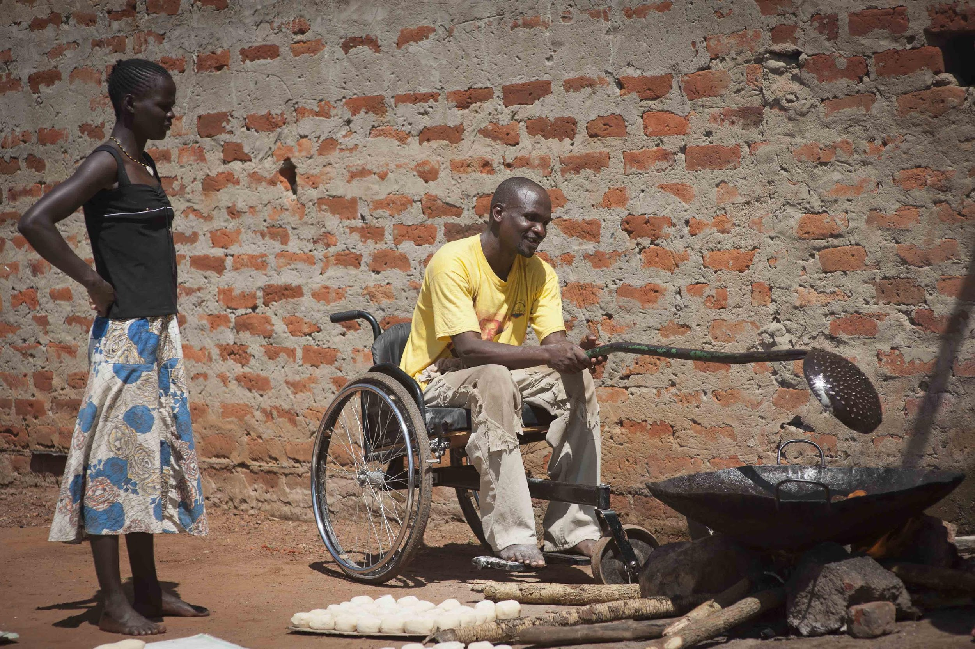
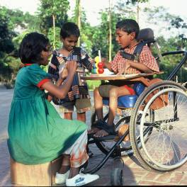
Wheelchair service training packages
WHO Guidelines
Professional service approach
Service levels: Basic and Intermediate
Minimum standards (40hrs)
Training resources

Slide 16
Training Packages supporting the 8 Steps
8 Steps | WHO Guidelines | WHO WSTP-b | WHO WSTP-i | WHO WSTP-m | WHO WSTP-s | WC Skills Program
1. Referral | ✪ | ✪✪ | ✪✪ | ✪✪✪ | ✪✪✪ | X
2. Assessment | ✪ | ✪✪✪✪ | ✪✪✪✪ | ✪ | ✪ | ✪✪✪✪
3. Prescription | ✪ | ✪✪✪✪ | ✪✪✪✪ | ✪ | ✪ | X
4. Ordering | ✪ | ✪✪ | ✪✪ | ✪✪✪✪ | ✪ | X
5. Product Prep | ✪ | ✪✪✪ | ✪✪✪ | ✪ | ✪ | X
6. Fit | ✪ | ✪✪✪✪ | ✪✪✪✪ | ✪ | ✪ | ✪✪
7. User Training | ✪ | ✪✪ | ✪✪ | ✪ | ✪ | ✪✪✪✪
8. Follow-up, Maintenance/repair | ✪ | ✪✪ | ✪✪ | ✪✪ | ✪✪ | ✪✪
X Step is not mentioned in the package
✪ Awareness raising only
✪✪ Minimal attention to training this step (less than 2 hours)
✪✪✪ Moderate attention to training this step (discussion, activities)
✪✪✪✪ Extensive attention to develop knowledge and skills for this step

Slide 17
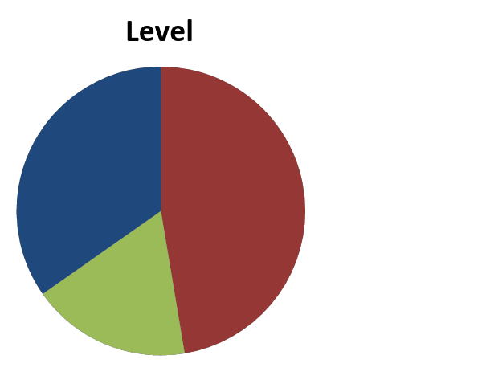
How is original material used?
Duration
LRS 3 – 35 hours
UMR 6 – 32 hours
HRS 2 - 45 hours
Practical: 66%
LMS & UMRS – practical with clients
HRS – a day in a wheelchair
Seating clinic
Testing: 88%
Majority practical
Basic +
Intermediate
Basic
Intermediate

Slide 18
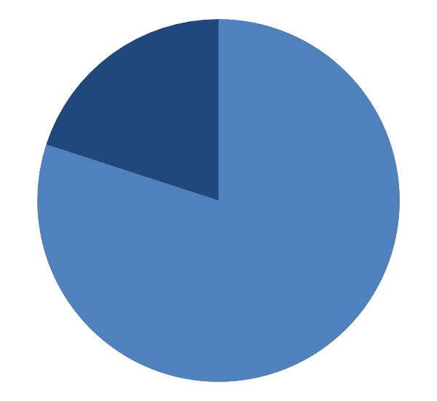
How is WSTP used?
Majority: Complete package (40 hours) vs part
Majority: One off module vs spread across curriculum
‘We implemented the standards set by WHO with modifications to adapt to our audience.’
Basic +
Intermediate
Basic
WSTP
Comments
WSTP is too much for some professions eg OTA.
Applicable for other eg CBR workers, Medics and paramedics
Challenges: ‘….needs more resources and training such as a different type of wheelchairs’.
‘Training done in collaboration with service providers. Availability of trainers’

Slide 19
Interest?
15 (21 %) not teaching | 1 not interested – uncertain of requirements and concerned about time
 | 14 interested in integrating wheelchair content 5 previously aware of WSTP 10 specifically interested in WSTP 5 had initiated the process towards integration Range of 1 to 35 hours available
‘Where can I view the wheelchair service training package curriculum’
‘Maybe it would also be good if we tap the current world federation of professionals (ex. WFOT, WCPT, etc) [ ] to encourage members associations to recognize WSTP curriculum integration.’

Slide 20
Summary
Interest in integrating wheelchair training
Large variety in how wheelchair provision education is trained
Lack of awareness of available training resources
Recommendations
Raise awareness of 8 steps and global resources
Analyze curriculums against the 8 steps
Carry out in depth interviews to explore facilitators and barriers and develop necessary resources in answer to FAQs

Slide 21
A Global Description of Wheelchair Service Education
1. Cross-Sectional Survey Study
2. In-Depth Qualitative Interview Study
3. Integration Pilot Sites

Slide 22
Aim
To develop an in-depth understanding of education regarding the wheelchair service provision process provided in Occupational Therapy, Physical Therapy and Prosthetics and Orthotics university programs located in low-, middle- and high-resourced settings geographically dispersed throughout the world.

Slide 23
Methods
Design: Semi-Structured Qualitative Interviews
Sampling Strategy: Purposive
Target Sample:
OT, PT, & O&P university programs integrating (or planning) wheelchair content
Resourced settings: low, medium, and high
Geographically dispersed
Procedure:
Semi-structured interview guide
Conducted through Adobe Connect
Audio recorded and transcribed verbatim
Data Analysis: Content analysis using Coding Analysis ToolKit program

Slide 24
Participating Sites
Winnipeg
Montreal
Hartford
Togo
Sudan
Honduras
Colombia
Notes:
Mostly North America (Canada [n=2] & US [n=1])
South America (Honduras) n=1
South America (Columbia) n=1
West Africa (Togo) n=1
North Africa (Sudan) n=1

Slide 25
Demographics
Setting (Country) | Education Degree | Profession (# of students) | State of Development of Wheelchair Course | When in curriculum?
LRS #1 (Togo) | Diploma | P&O (16) PT (20) | in development | P&O: 3rd yr PT: 2nd yr
LRS #2 (Sudan) | Diploma | P&O (15) | 1st time | 1st yr
LMRS #1 (Honduras) | College Degree, not Bachelor’s | FT (50-60) | in development | 2nd yr
UMRS #1 (Colombia) | Bachelor’s | PT (15-20) | in development | 5th, 6th or 7th semester (10 semesters total)
HRS #1 (Canada) | Bachelor’s/Professional Master’s continuum | OT (31) | 1st time | 2nd yr, mostly Master’s level
HRS #2 (Canada) | Professional Master’s | OT (50) | established | 1st & 2nd yr
HRS #3 (US) | Doctorate | PT (40) | established | 1st, 2nd & 3rd yr
LRS/LMRS/UMRS/HRS = low/low-middle/upper-middle/high resourced setting; P&O = Prosthetics & Orthotics; PT = Physiotherapy; FT = Functional Therapy; OT = Occupational Therapy; yr = year.
Notes:
university names

Slide 26
Most Sites Cover All 8 Wheelchair Service Provision Process Steps
in use
planned use
not used
Institution | 1: Referral | 2: Assessment | 3: Prescription | 4: Product Preparation | 5: Funding | 6: Fitting | 7: User Training | 8: F/U & Maintenance
LRS #1
LRS #2
LMRS #1
UMRS #1
HRS #1
HRS #2
HRS #3

Slide 27
Most Sites Use WSTP-B + Supplementary Materials
in use
planned use
not used
Institution | WSTP Basic | WSTP Intermediate | Others
LRS #1
LRS #2 |  |  | Motivation products
LMRS #1 |  |  | Original material
UMRS #1 |  |  | Original material
HRS #1 |  |  | Original material Wheelchair Skills Program GF Strong Rehab Center Maintenance Program
HRS #2 |  |  | Original material Wheelchair Skills Program
HRS #3 |  |  | Original material

Slide 28
Most Sites Use WSTP-B + Supplementary Materials
in use
planned use
not used
Institution | WSTP Basic | WSTP Intermediate | Others
LRS #1
LRS #2 |  |  | Motivation products
LMRS #1 |  |  | Original material
UMRS #1 |  |  | Original material
HRS #1 |  |  | Original material Wheelchair Skills Program GF Strong Rehab Center Maintenance Program
HRS #2 |  |  | Original material Wheelchair Skills Program
HRS #3 |  |  | Original material
“For the intermediate [level of WSTP], we are trying to, but otherwise it can be more for professionals. […] We are starting [to apply for] some funds for wheelchairs for the intermediate [course], […] so that we can start that training.”

Slide 29
Most Sites Use WSTP-B + Supplementary Materials
in use
planned use
not used
Institution | WSTP Basic | WSTP Intermediate | Others
LRS #1
LRS #2 |  |  | Motivation products
LMRS #1 |  |  | Original material
UMRS #1 |  |  | Original material
HRS #1 |  |  | Original material Wheelchair Skills Program GF Strong Rehab Center Maintenance Program
HRS #2 |  |  | Original material Wheelchair Skills Program
HRS #3 |  |  | Original material
“No, to tell the truth, I am aware of some of the WHO materials but I didn’t know there was information on wheelchairs.”

Slide 30
Most Sites Use WSTP-B + Supplementary Materials
in use
planned use
not used
Institution | WSTP Basic | WSTP Intermediate | Others
LRS #1
LRS #2 |  |  | Motivation products
LMRS #1 |  |  | Original material
UMRS #1 |  |  | Original material
HRS #1 |  |  | Original material Wheelchair Skills Program GF Strong Rehab Center Maintenance Program
HRS #2 |  |  | Original material Wheelchair Skills Program
HRS #3 |  |  | Original material
“The WHO material, one of the things I used it for was the 8-steps as a way of organising and structuring the content. Much of that content was there already, but it wasn't necessarily organized or structured in that.”

Slide 31
Most Sites Use WSTP-B + Supplementary Materials
in use
planned use
not used
Institution | WSTP Basic | WSTP Intermediate | Others
LRS #1
LRS #2 |  |  | Motivation products
LMRS #1 |  |  | Original material
UMRS #1 |  |  | Original material
HRS #1 |  |  | Original material Wheelchair Skills Program GF Strong Rehab Center Maintenance Program
HRS #2 |  |  | Original material Wheelchair Skills Program
HRS #3 |  |  | Original material
“… we moved on to do evaluation of other components, wheelchair skills using the Wheelchair Skills Program… wheelchair confidence using an assessment called the WheelCon .”
“… prescription and selection of a wheelchair and how to finance it… that information was less focused on WHO materials and more context-specific… here in the province of Quebec… a wheelchair is funded by RAMQ and there is very specific assessment form that has to be completed.”

Slide 32
All Sites Use Lecture & Practical Pedagogical Approaches
in use
planned use
not used
Institutions | Duration | Lectures | Online | Practical Methods
LRS #1 | 40h |  |  | Provide wheelchair service to actual clients: “groups of 2 students per client with total of 10 clients (1 wheelchair per client) for 20 students and 4 trainers in lab”
LRS #2 | 40h |  |  | Follows WSTP Course
LMRS #1 | TBA |  |  | Lab workshops
UMRS #1 | 32-36h |  |  | Lab workshops
HRS #1 | 2nd year: 3h Master’s: 45h |  |  | Lab workshops, Day in a wheelchair, Presentations from representatives of different manufactures,
HRS #2 | 28h |  |  | Lab workshops, Day in a wheelchair, Boot camp on weekend (WSP)
HRS #3 | 1st year: 7h 2nd year: 30h 3rd year: ? |  |  | Lab workshops, Day in a wheelchair, Model clients, Actual home assessment, Van modification
Notes:
No online learning modules, but resources were available online.

Slide 33
All Sites Use Lecture & Practical Pedagogical Approaches
in use
planned use
not used
Institutions | Duration | Lectures | Online | Practical Methods
LRS #1 | 40h |  |  | Provide wheelchair service to actual clients: “groups of 2 students per client with total of 10 clients (1 wheelchair per client) for 20 students and 4 trainers in lab”
LRS #2 | 40h |  |  | Follows WSTP Course
LMRS #1 | TBA |  |  | Lab workshops
UMRS #1 | 32-36h |  |  | Lab workshops
HRS #1 | 2nd year: 3h Master’s: 45h |  |  | Lab workshops, Day in a wheelchair, Presentations from representatives of different manufactures,
HRS #2 | 28h |  |  | Lab workshops, Day in a wheelchair, Boot camp on weekend (WSP)
HRS #3 | 1st year: 7h 2nd year: 30h 3rd year: ? |  |  | Lab workshops, Day in a wheelchair, Model clients, Actual home assessment, Van modification
“The practical conducted at the school, we are inviting the clients for them. We will call the clients so that [the students] can practice in the real situation.”
Notes:
No online learning modules, but resources were available online.

Slide 34
All Sites Use Lecture & Practical Pedagogical Approaches
in use
planned use
not used
Institutions | Duration | Lectures | Online | Practical Methods
LRS #1 | 40h |  |  | Provide wheelchair service to actual clients: “groups of 2 students per client with total of 10 clients (1 wheelchair per client) for 20 students and 4 trainers in lab”
LRS #2 | 40h |  |  | Follows WSTP Course
LMRS #1 | TBA |  |  | Lab workshops
UMRS #1 | 32-36h |  |  | Lab workshops
HRS #1 | 2nd year: 3h Master’s: 45h |  |  | Lab workshops, Day in a wheelchair, Presentations from representatives of different manufactures,
HRS #2 | 28h |  |  | Lab workshops, Day in a wheelchair, Boot camp on weekend (WSP)
HRS #3 | 1st year: 7h 2nd year: 30h 3rd year: ? |  |  | Lab workshops, Day in a wheelchair, Model clients, Actual home assessment, Van modification
“I think for now, we are aiming to introduce the training itself,
but within it, we use the WHO basic.”
Notes:
No online learning modules, but resources were available online.

Slide 35
All Sites Use Lecture & Practical Pedagogical Approaches
in use
planned use
not used
Institutions | Duration | Lectures | Online | Practical Methods
LRS #1 | 40h |  |  | Provide wheelchair service to actual clients: “groups of 2 students per client with total of 10 clients (1 wheelchair per client) for 20 students and 4 trainers in lab”
LRS #2 | 40h |  |  | Follows WSTP Course
LMRS #1 | TBA |  |  | Lab workshops
UMRS #1 | 32-36h |  |  | Lab workshops
HRS #1 | 2nd year: 3h Master’s: 45h |  |  | Lab workshops, Day in a wheelchair, Presentations from representatives of different manufactures,
HRS #2 | 28h |  |  | Lab workshops, Day in a wheelchair, Boot camp on weekend (WSP)
HRS #3 | 1st year: 7h 2nd year: 30h 3rd year: ? |  |  | Lab workshops, Day in a wheelchair, Model clients, Actual home assessment, Van modification
“I think that it would be most pertinent to have the first approach from the point of theoretical aspects and then to have then the practical component. The virtual aspect would complement the subject, but the subject would not be completely virtual. There would be the theoretical lectures.”
Notes:
No online learning modules, but resources were available online.

Slide 36
All Sites Use Lecture & Practical Pedagogical Approaches
in use
planned use
not used
Institutions | Duration | Lectures | Online | Practical Methods
LRS #1 | 40h |  |  | Provide wheelchair service to actual clients: “groups of 2 students per client with total of 10 clients (1 wheelchair per client) for 20 students and 4 trainers in lab”
LRS #2 | 40h |  |  | Follows WSTP Course
LMRS #1 | TBA |  |  | Lab workshops
UMRS #1 | 32-36h |  |  | Lab workshops
HRS #1 | 2nd year: 3h Master’s: 45h |  |  | Lab workshops, Day in a wheelchair, Presentations from representatives of different manufactures,
HRS #2 | 28h |  |  | Lab workshops, Day in a wheelchair, Boot camp on weekend (WSP)
HRS #3 | 1st year: 7h 2nd year: 30h 3rd year: ? |  |  | Lab workshops, Day in a wheelchair, Model clients, Actual home assessment, Van modification
“We developed case studies and the students were in groups of 3. And they each had a different case study with a different population, diagnosis, adults, older adults, paediatrics. The intent was for 1 student to act as the occupational therapist, 1 student to act as the wheelchair user and 1 student to act as the caregiver.”
Notes:
No online learning modules, but resources were available online.

Slide 37
All Sites Use Lecture & Practical Pedagogical Approaches
in use
planned use
not used
Institutions | Duration | Lectures | Online | Practical Methods
LRS #1 | 40h |  |  | Provide wheelchair service to actual clients: “groups of 2 students per client with total of 10 clients (1 wheelchair per client) for 20 students and 4 trainers in lab”
LRS #2 | 40h |  |  | Follows WSTP Course
LMRS #1 | TBA |  |  | Lab workshops
UMRS #1 | 32-36h |  |  | Lab workshops
HRS #1 | 2nd year: 3h Master’s: 45h |  |  | Lab workshops, Day in a wheelchair, Presentations from representatives of different manufactures,
HRS #2 | 28h |  |  | Lab workshops, Day in a wheelchair, Boot camp on weekend (WSP)
HRS #3 | 1st year: 7h 2nd year: 30h 3rd year: ? |  |  | Lab workshops, Day in a wheelchair, Model clients, Actual home assessment, Van modification
“I reach out if [my clinical clients] are interested in helping out with the class. Some are interested in coming to talk to the students, [… and] others are really interested [in having the students do hands-on] and they will be happy to come in as patient models.”
Notes:
No online learning modules, but resources were available online.

Slide 38
Most Sites Assess Knowledge Using a Written & Practical Exam
in use
planned use
not used
Institutions | Theoretical Written Exam | Practical Exams | Assignments/Projects
LRS #1 |  | practical exam: demonstration of skills
LRS #2 |  | TBD
LMRS #1 |  | practical exam
UMRS #1 |  | practical exam
HRS #1 |  | exam stations for 8 steps case studies quiz | presentation case studies
HRS #2 |  | program a wheelchair assess & train user
HRS #3 |  | participation | funding letter of justification

Slide 39
Most Sites Assess Knowledge Using a Written & Practical Exam
in use
planned use
not used
Institutions | Theoretical Written Exam | Practical Exams | Assignments/Projects
LRS #1 |  | practical exam: demonstration of skills
LRS #2 |  | TBD
LMRS #1 |  | practical exam
UMRS #1 |  | practical exam
HRS #1 |  | exam stations for 8 steps case studies quiz | presentation case studies
HRS #2 |  | program a wheelchair assess & train user
HRS #3 |  | participation | funding letter of justification
“So there will be a practical and a theoretical session in the examination time. […] a set of questionnaires [to test competence] before we start the training and then after we finish the training. We will make our own tests. [For practical exam,] they can come pick a question there and ask them to practice in front of us, so that we can evaluate if they are able to do it, how they assist a wheelchair user to propel, up the stairs, something like that.”

Slide 40
Most Sites Assess Knowledge Using a Written & Practical Exam
in use
planned use
not used
Institutions | Theoretical Written Exam | Practical Exams | Assignments/Projects
LRS #1 |  | practical exam: demonstration of skills
LRS #2 |  | TBD
LMRS #1 |  | practical exam
UMRS #1 |  | practical exam
HRS #1 |  | exam stations for 8 steps case studies quiz | presentation case studies
HRS #2 |  | program a wheelchair assess & train user
HRS #3 |  | participation | funding letter of justification
“We set up wheelchairs based on their case studies [...]. according to [the students’] prescription, but we maladjusted each chair with two or three things wrong, so that they could …go through the process of the Safe and Ready Checklist to figure out what was wrong with the chair and then present it to the group.”

Slide 41
Most Sites Assess Knowledge Using a Written & Practical Exam
in use
planned use
not used
Institutions | Theoretical Written Exam | Practical Exams | Assignments/Projects
LRS #1 |  | practical exam: demonstration of skills
LRS #2 |  | TBD
LMRS #1 |  | practical exam
UMRS #1 |  | practical exam
HRS #1 |  | exam stations for 8 steps case studies quiz | presentation case studies
HRS #2 |  | program a wheelchair assess & train user
HRS #3 |  | participation | funding letter of justification
“… they will have to demonstrate that they can assess and train someone in a wheelchair.”

Slide 42
Barriers & Facilitators to Integration of Wheelchair Content
Barriers | Facilitators
Lack of wheelchair service provision services in the country | Support from university directors, chairs of programs, & students
Advocacy efforts large in scope | Collaborations (ex: wheelchair providers; content experts / experienced instructors)
Lack of equipment resources (ex: wheelchairs) | Motivation (of students and professors); Flexibility of curriculum
Lack of space (ex: to run labs, to store equipment) | Availability of space
Lack of time in curriculum | Wheelchair donations & loans
Location of course (ex: time-consuming transit for students) | Access to materials supported by the WHO
Poor Internet connection | Location close to resources
Lack of training for professors in use of WSTPs | Positive course evaluations & research study findings
Lack of support as mandatory course | Availability of optional courses in curriculums
 | Program type (ex: extension to Professional PhD)

Slide 43
Barriers & Facilitators to Integration of Wheelchair Content
Barriers | Facilitators
Lack of wheelchair service provision services in the country | Support from university directors, chairs of programs, & students
Advocacy efforts large in scope | Collaborations (ex: wheelchair providers; content experts / experienced instructors)
Lack of equipment resources (ex: wheelchairs) | Motivation (of students and professors); Flexibility of curriculum
Lack of space (ex: to run labs, to store equipment) | Availability of space
Lack of time in curriculum | Wheelchair donations & loans
Location of course (ex: time-consuming transit for students) | Access to materials supported by the WHO
Poor Internet connection | Location close to resources
Lack of training for professors in use of WSTPs | Positive course evaluations & research study findings
Lack of support as mandatory course | Availability of optional courses in curriculums
 | Program type (ex: extension to Professional PhD)
“Nothing exists for wheelchair service provision within the country [...] but obviously, it is needed. […] We still advocate for social inclusion…” LRS # 2

Slide 44
Barriers & Facilitators to Integration of Wheelchair Content
Barriers | Facilitators
Lack of wheelchair service provision services in the country | Support from university directors, chairs of programs, & students
Advocacy efforts large in scope | Collaborations (ex: wheelchair providers; content experts / experienced instructors)
Lack of equipment resources (ex: wheelchairs) | Motivation (of students and professors); Flexibility of curriculum
Lack of space (ex: to run labs, to store equipment) | Availability of space
Lack of time in curriculum | Wheelchair donations & loans
Location of course (ex: time-consuming transit for students) | Access to materials supported by the WHO
Poor Internet connection | Location close to resources
Lack of training for professors in use of WSTPs | Positive course evaluations & research study findings
Lack of support as mandatory course | Availability of optional courses in curriculums
 | Program type (ex: extension to Professional PhD)
“Market research needed to inform the need of the wheelchair-related course.”
LMRS # 1

Slide 45
Barriers & Facilitators to Integration of Wheelchair Content
Barriers | Facilitators
Lack of wheelchair service provision services in the country | Support from university directors, chairs of programs, & students
Advocacy efforts large in scope | Collaborations (ex: wheelchair providers; content experts / experienced instructors)
Lack of equipment resources (ex: wheelchairs) | Motivation (of students and professors); Flexibility of curriculum
Lack of space (ex: to run labs, to store equipment) | Availability of space
Lack of time in curriculum | Wheelchair donations & loans
Location of course (ex: time-consuming transit for students) | Access to materials supported by the WHO
Poor Internet connection | Location close to resources
Lack of training for professors in use of WSTPs | Positive course evaluations & research study findings
Lack of support as mandatory course | Availability of optional courses in curriculums
 | Program type (ex: extension to Professional PhD)
“The whole uncertainty as to when and if we receive our products…”
LRS # 2
“There are literally space restraints and equipment restraints...”
HRS # 1

Slide 46
Barriers & Facilitators to Integration of Wheelchair Content
Barriers | Facilitators
Lack of wheelchair service provision services in the country | Support from university directors, chairs of programs, & students
Advocacy efforts large in scope | Collaborations (ex: wheelchair providers; content experts / experienced instructors)
Lack of equipment resources (ex: wheelchairs) | Motivation (of students and professors); Flexibility of curriculum
Lack of space (ex: to run labs, to store equipment) | Availability of space
Lack of time in curriculum | Wheelchair donations & loans
Location of course (ex: time-consuming transit for students) | Access to materials supported by the WHO
Poor Internet connection | Location close to resources
Lack of training for professors in use of WSTPs | Positive course evaluations & research study findings
Lack of support as mandatory course | Availability of optional courses in curriculums
 | Program type (ex: extension to Professional PhD)
“Some of our challenges are having a good place to store equipment and enough space to do all this.”
HRS # 3

Slide 47
Barriers & Facilitators to Integration of Wheelchair Content
Barriers | Facilitators
Lack of wheelchair service provision services in the country | Support from university directors, chairs of programs, & students
Advocacy efforts large in scope | Collaborations (ex: wheelchair providers; content experts / experienced instructors)
Lack of equipment resources (ex: wheelchairs) | Motivation (of students and professors); Flexibility of curriculum
Lack of space (ex: to run labs, to store equipment) | Availability of space
Lack of time in curriculum | Wheelchair donations & loans
Location of course (ex: time-consuming transit for students) | Access to materials supported by the WHO
Poor Internet connection | Location close to resources
Lack of training for professors in use of WSTPs | Positive course evaluations & research study findings
Lack of support as mandatory course | Availability of optional courses in curriculums
 | Program type (ex: extension to Professional PhD)
“For PT, there is a big issue to include the 40 hours in their curriculum, they still working on...”
LRS # 1
“Finding the hours to do that. [Master’s OT program] is pretty full and pretty busy as are all the programs across the country. […] So that was the biggest issue in terms of advocacy to get the time.”
HRS # 2

Slide 48
Barriers & Facilitators to Integration of Wheelchair Content
Barriers | Facilitators
Lack of wheelchair service provision services in the country | Support from university directors, chairs of programs, & students
Advocacy efforts large in scope | Collaborations (ex: wheelchair providers; content experts / experienced instructors)
Lack of equipment resources (ex: wheelchairs) | Motivation (of students and professors); Flexibility of curriculum
Lack of space (ex: to run labs, to store equipment) | Availability of space
Lack of time in curriculum | Wheelchair donations & loans
Location of course (ex: time-consuming transit for students) | Access to materials supported by the WHO
Poor Internet connection | Location close to resources
Lack of training for professors in use of WSTPs | Positive course evaluations & research study findings
Lack of support as mandatory course | Availability of optional courses in curriculums
 | Program type (ex: extension to Professional PhD)
“From a student’s perspective, it was also a challenge, as the course was located at Marie Enfant Rehabilitation Centre, which is not near the School.”
HRS # 1

Slide 49
Barriers & Facilitators to Integration of Wheelchair Content
Barriers | Facilitators
Lack of wheelchair service provision services in the country | Support from university directors, chairs of programs, & students
Advocacy efforts large in scope | Collaborations (ex: wheelchair providers; content experts / experienced instructors)
Lack of equipment resources (ex: wheelchairs) | Motivation (of students and professors); Flexibility of curriculum
Lack of space (ex: to run labs, to store equipment) | Availability of space
Lack of time in curriculum | Wheelchair donations & loans
Location of course (ex: time-consuming transit for students) | Access to materials supported by the WHO
Poor Internet connection | Location close to resources
Lack of training for professors in use of WSTPs | Positive course evaluations & research study findings
Lack of support as mandatory course | Availability of optional courses in curriculums
 | Program type (ex: extension to Professional PhD)
“I failed in 1 [ISWP basic competency test], because of the network connection. I did not have enough bandwidth to go through all of the questions.”
“… the network connection is not very stable in the country. Sometimes, it is very good, but the next day, it is cutting out. Online components not possible because of the poor network connection.”
LRS # 1

Slide 50
Barriers & Facilitators to Integration of Wheelchair Content
Barriers | Facilitators
Lack of wheelchair service provision services in the country | Support from university directors, chairs of programs, & students
Advocacy efforts large in scope | Collaborations (ex: wheelchair providers; content experts / experienced instructors)
Lack of equipment resources (ex: wheelchairs) | Motivation (of students and professors); Flexibility of curriculum
Lack of space (ex: to run labs, to store equipment) | Availability of space
Lack of time in curriculum | Wheelchair donations & loans
Location of course (ex: time-consuming transit for students) | Access to materials supported by the WHO
Poor Internet connection | Location close to resources
Lack of training for professors in use of WSTPs | Positive course evaluations & research study findings
Lack of support as mandatory course | Availability of optional courses in curriculums
 | Program type (ex: extension to Professional PhD)
“I hadn’t been trained in those materials. I was learning as I went along.”
HRS # 1

Slide 51
Barriers & Facilitators to Integration of Wheelchair Content
Barriers | Facilitators
Lack of wheelchair service provision services in the country | Support from university directors, chairs of programs, & students
Advocacy efforts large in scope | Collaborations (ex: wheelchair providers; content experts / experienced instructors)
Lack of equipment resources (ex: wheelchairs) | Motivation (of students and professors); Flexibility of curriculum
Lack of space (ex: to run labs, to store equipment) | Availability of space
Lack of time in curriculum | Wheelchair donations & loans
Location of course (ex: time-consuming transit for students) | Access to materials supported by the WHO
Poor Internet connection | Location close to resources
Lack of training for professors in use of WSTPs | Positive course evaluations & research study findings
Lack of support as mandatory course | Availability of optional courses in curriculums
 | Program type (ex: extension to Professional PhD)
“Getting approval in general for a wheelchair-specific course […], because […] the pedagogic committee was not necessarily onboard with something so targeted.”
HRS # 1

Slide 52
Barriers & Facilitators to Integration of Wheelchair Content
Barriers | Facilitators
Lack of wheelchair service provision services in the country | Support from university directors, chairs of programs, & students
Advocacy efforts large in scope | Collaborations (ex: wheelchair providers; content experts / experienced instructors)
Lack of equipment resources (ex: wheelchairs) | Motivation (of students and professors); Flexibility of curriculum
Lack of space (ex: to run labs, to store equipment) | Availability of space
Lack of time in curriculum | Wheelchair donations & loans
Location of course (ex: time-consuming transit for students) | Access to materials supported by the WHO
Poor Internet connection | Location close to resources
Lack of training for professors in use of WSTPs | Positive course evaluations & research study findings
Lack of support as mandatory course | Availability of optional courses in curriculums
 | Program type (ex: extension to Professional PhD)
“My department was quite receptive; we do have a keen interest in assistive technology, so that sort of predisposed us to being open to ideas of expanding wheelchair content.”
HRS # 2

Slide 53
Barriers & Facilitators to Integration of Wheelchair Content
Barriers | Facilitators
Lack of wheelchair service provision services in the country | Support from university directors, chairs of programs, & students
Advocacy efforts large in scope | Collaborations (ex: wheelchair providers; content experts / experienced instructors)
Lack of equipment resources (ex: wheelchairs) | Motivation (of students and professors); Flexibility of curriculum
Lack of space (ex: to run labs, to store equipment) | Availability of space
Lack of time in curriculum | Wheelchair donations & loans
Location of course (ex: time-consuming transit for students) | Access to materials supported by the WHO
Poor Internet connection | Location close to resources
Lack of training for professors in use of WSTPs | Positive course evaluations & research study findings
Lack of support as mandatory course | Availability of optional courses in curriculums
 | Program type (ex: extension to Professional PhD)
“Collaborations with the Center Purchasing Material, which is based in Togo, covered at Centre pour personnes handicapées. LRS # 1
“…collaborations with patients in clinic, Home Assessment Program, Van Modification Program, major equipment-recycling center in Connecticut.”
HRS # 3

Slide 54
Barriers & Facilitators to Integration of Wheelchair Content
Barriers | Facilitators
Lack of wheelchair service provision services in the country | Support from university directors, chairs of programs, & students
Advocacy efforts large in scope | Collaborations (ex: wheelchair providers; content experts / experienced instructors)
Lack of equipment resources (ex: wheelchairs) | Motivation (of students and professors); Flexibility of curriculum
Lack of space (ex: to run labs, to store equipment) | Availability of space
Lack of time in curriculum | Wheelchair donations & loans
Location of course (ex: time-consuming transit for students) | Access to materials supported by the WHO
Poor Internet connection | Location close to resources
Lack of training for professors in use of WSTPs | Positive course evaluations & research study findings
Lack of support as mandatory course | Availability of optional courses in curriculums
 | Program type (ex: extension to Professional PhD)
“Teachers are highly motivated. The students are also motivated, so I do not perceive that there maybe some obstacles that prevent the project to be done.”
UMRS # 1
“Flexibility in place, because […] the students are taking a class on a weekend, which is unorthodox for them.”
HRS # 2

Slide 55
Barriers & Facilitators to Integration of Wheelchair Content
Barriers | Facilitators
Lack of wheelchair service provision services in the country | Support from university directors, chairs of programs, & students
Advocacy efforts large in scope | Collaborations (ex: wheelchair providers; content experts / experienced instructors)
Lack of equipment resources (ex: wheelchairs) | Motivation (of students and professors); Flexibility of curriculum
Lack of space (ex: to run labs, to store equipment) | Availability of space
Lack of time in curriculum | Wheelchair donations & loans
Location of course (ex: time-consuming transit for students) | Access to materials supported by the WHO
Poor Internet connection | Location close to resources
Lack of training for professors in use of WSTPs | Positive course evaluations & research study findings
Lack of support as mandatory course | Availability of optional courses in curriculums
 | Program type (ex: extension to Professional PhD)
“In my lab space, I have the Wheelchair Skills Program obstacle course set up”
HRS # 1

Slide 56
Barriers & Facilitators to Integration of Wheelchair Content
Barriers | Facilitators
Lack of wheelchair service provision services in the country | Support from university directors, chairs of programs, & students
Advocacy efforts large in scope | Collaborations (ex: wheelchair providers; content experts / experienced instructors)
Lack of equipment resources (ex: wheelchairs) | Motivation (of students and professors); Flexibility of curriculum
Lack of space (ex: to run labs, to store equipment) | Availability of space
Lack of time in curriculum | Wheelchair donations & loans
Location of course (ex: time-consuming transit for students) | Access to materials supported by the WHO
Poor Internet connection | Location close to resources
Lack of training for professors in use of WSTPs | Positive course evaluations & research study findings
Lack of support as mandatory course | Availability of optional courses in curriculums
 | Program type (ex: extension to Professional PhD)
“… Latter-Day Saints Church & Motivation: provide wheelchairs to actual clients…”
LRS # 1
“Four donated manual wheelchairs […] and […] 6 or 7 wheelchairs […] loaned from local distributors”
HRS # 1

Slide 57
Barriers & Facilitators to Integration of Wheelchair Content
Barriers | Facilitators
Lack of wheelchair service provision services in the country | Support from university directors, chairs of programs, & students
Advocacy efforts large in scope | Collaborations (ex: wheelchair providers; content experts / experienced instructors)
Lack of equipment resources (ex: wheelchairs) | Motivation (of students and professors); Flexibility of curriculum
Lack of space (ex: to run labs, to store equipment) | Availability of space
Lack of time in curriculum | Wheelchair donations & loans
Location of course (ex: time-consuming transit for students) | Access to materials supported by the WHO
Poor Internet connection | Location close to resources
Lack of training for professors in use of WSTPs | Positive course evaluations & research study findings
Lack of support as mandatory course | Availability of optional courses in curriculums
 | Program type (ex: extension to Professional PhD)
“It helped that ICRC was recommending that the wheelchair service content was included to get acceptance from the National Academic Committee and that it was a [package from] WHO, […] which has the respect.”
LRS # 2

Slide 58
Barriers & Facilitators to Integration of Wheelchair Content
Barriers | Facilitators
Lack of wheelchair service provision services in the country | Support from university directors, chairs of programs, & students
Advocacy efforts large in scope | Collaborations (ex: wheelchair providers; content experts / experienced instructors)
Lack of equipment resources (ex: wheelchairs) | Motivation (of students and professors); Flexibility of curriculum
Lack of space (ex: to run labs, to store equipment) | Availability of space
Lack of time in curriculum | Wheelchair donations & loans
Location of course (ex: time-consuming transit for students) | Access to materials supported by the WHO
Poor Internet connection | Location close to resources
Lack of training for professors in use of WSTPs | Positive course evaluations & research study findings
Lack of support as mandatory course | Availability of optional courses in curriculums
 | Program type (ex: extension to Professional PhD)
“Located physically very near our major equipment-recycling center here […]. So I […] use their facility and their equipment during the course.”
HRS # 3

Slide 59
Barriers & Facilitators to Integration of Wheelchair Content
Barriers | Facilitators
Lack of wheelchair service provision services in the country | Support from university directors, chairs of programs, & students
Advocacy efforts large in scope | Collaborations (ex: wheelchair providers; content experts / experienced instructors)
Lack of equipment resources (ex: wheelchairs) | Motivation (of students and professors); Flexibility of curriculum
Lack of space (ex: to run labs, to store equipment) | Availability of space
Lack of time in curriculum | Wheelchair donations & loans
Location of course (ex: time-consuming transit for students) | Access to materials supported by the WHO
Poor Internet connection | Location close to resources
Lack of training for professors in use of WSTPs | Positive course evaluations & research study findings
Lack of support as mandatory course | Availability of optional courses in curriculums
 | Program type (ex: extension to Professional PhD)
“At course evaluation, 100% of students said, ”The course was useful for my education.”
HRS # 1
“[Students’] evaluation of the boot camp was very positive and […] identifying it is a valuable thing and that it is worthwhile doing and then it is easy to advocate doing …”
HRS # 2

Slide 60
Barriers & Facilitators to Integration of Wheelchair Content
Barriers | Facilitators
Lack of wheelchair service provision services in the country | Support from university directors, chairs of programs, & students
Advocacy efforts large in scope | Collaborations (ex: wheelchair providers; content experts / experienced instructors)
Lack of equipment resources (ex: wheelchairs) | Motivation (of students and professors); Flexibility of curriculum
Lack of space (ex: to run labs, to store equipment) | Availability of space
Lack of time in curriculum | Wheelchair donations & loans
Location of course (ex: time-consuming transit for students) | Access to materials supported by the WHO
Poor Internet connection | Location close to resources
Lack of training for professors in use of WSTPs | Positive course evaluations & research study findings
Lack of support as mandatory course | Availability of optional courses in curriculums
 | Program type (ex: extension to Professional PhD)
“The electives courses have that advantage, theoretical and practical components.”
UMRS # 1

Slide 61
Barriers & Facilitators to Integration of Wheelchair Content
Barriers | Facilitators
Lack of wheelchair service provision services in the country | Support from university directors, chairs of programs, & students
Advocacy efforts large in scope | Collaborations (ex: wheelchair providers; content experts / experienced instructors)
Lack of equipment resources (ex: wheelchairs) | Motivation (of students and professors); Flexibility of curriculum
Lack of space (ex: to run labs, to store equipment) | Availability of space
Lack of time in curriculum | Wheelchair donations & loans
Location of course (ex: time-consuming transit for students) | Access to materials supported by the WHO
Poor Internet connection | Location close to resources
Lack of training for professors in use of WSTPs | Positive course evaluations & research study findings
Lack of support as mandatory course | Availability of optional courses in curriculums
 | Program type (ex: extension to Professional PhD)
“…when it was Master’s program, it was a little over 2 years, almost 2 and a half years. Then it changed over a few years ago to a doctoral level program, which in the US now, that is now the minimum required degree for licensure for physical therapist in the US. … that gives a lot of opportunity to add a lot of things that you might not otherwise have.
HRS # 3

Slide 62
A Global Description of Wheelchair Service Education
1. Cross-Sectional Survey Study
2. In-Depth Qualitative Interview Study
3. Integration Pilot Sites

Slide 63
Integration Pilot Sites - Purpose
Include/enhance wheelchair content in educational programs
Use globally available resources as appropriate
Notes:
The purpose of the integration pilot sites project is to encourage and support the educational institutions to include or enhance wheelchair content in their courses and to use globally available resources as appropriate.

Slide 64
Integration Pilot Sites - Methods
14 potentials partners worldwide.
Based on readiness to integrate new content, methodology or ISWP tests.
Joint meetings held monthly since August 2016.
‘Integration toolkit’ in development for educational institutions.
Resources
Current offerings:
ISWP Wheelchair Service Provision Basic test ( 6 languages)
Hybrid course (2 languages)
Notes:
Through various networks and conferences, the group identified 14 potential partner institutions, from various parts of the world and representing the varied rehabilitation professions.
Institutions were identified based on readiness to integrate new content, methodology or testing mechanism available through ISWP.
and these will continue into the first half of 2017 until each institution has implemented and evaluated planned activities.
Through this process, ISWP will gather and develop resources, approaches, case studies and example curricula which can be included in an ‘integration toolkit’ for future use by other educational institutions.

Slide 65
Integration Pilot Sites
Winnipeg
Montreal
Nashville
Hartford
Nepal
India
Chiang Mai
Sudan
Laos
Togo
Bangkok
Cambodia
Colombia
Brazil

Slide 66
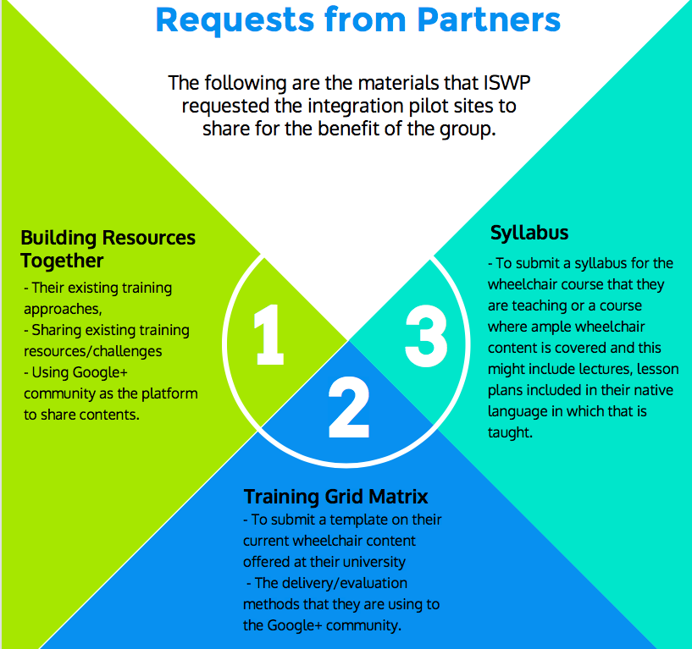

Slide 67
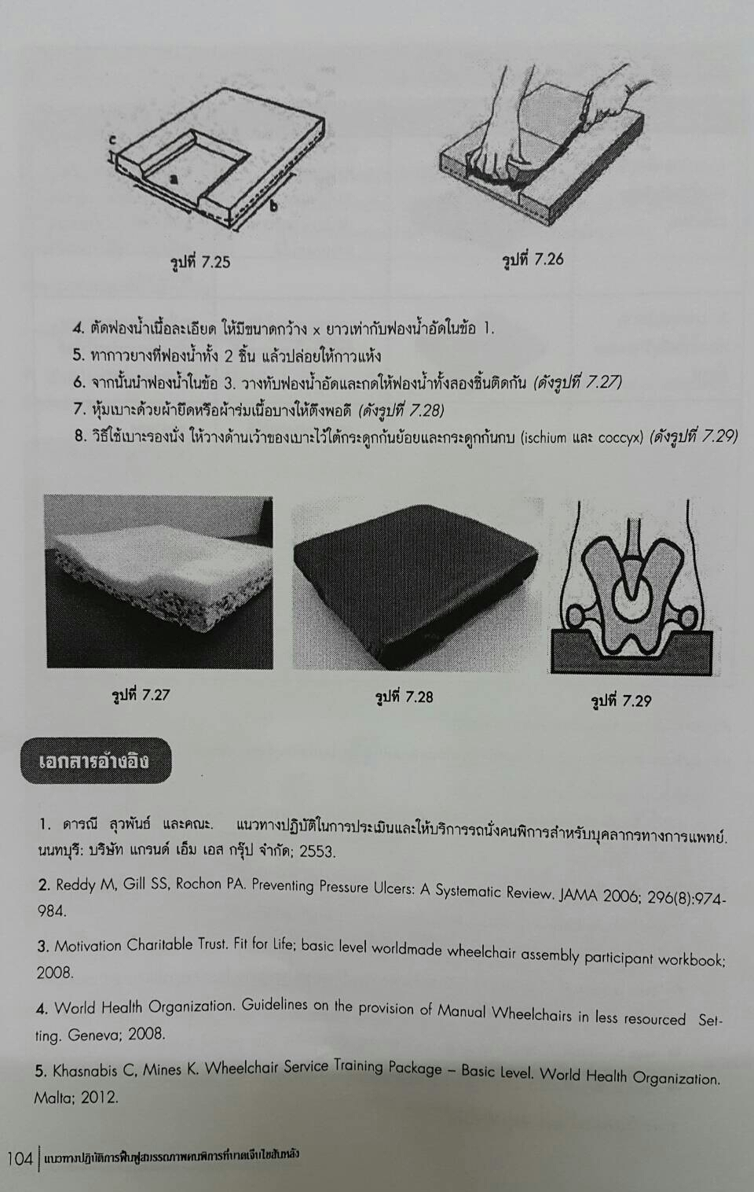
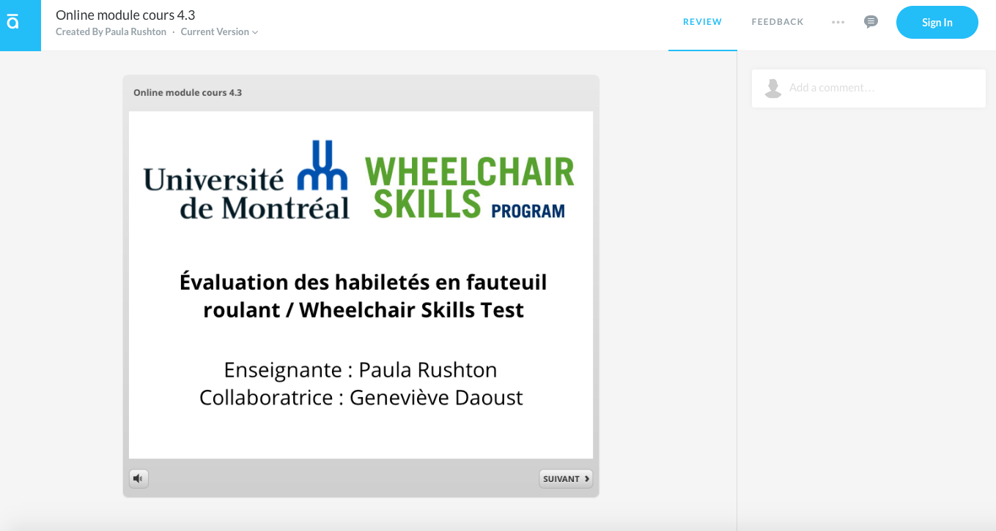
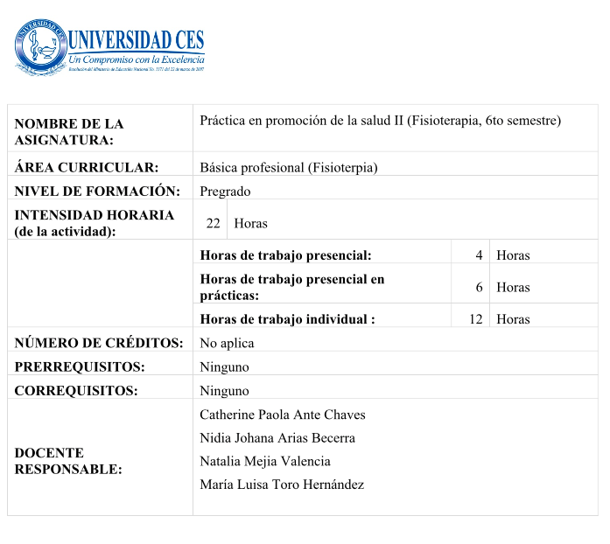
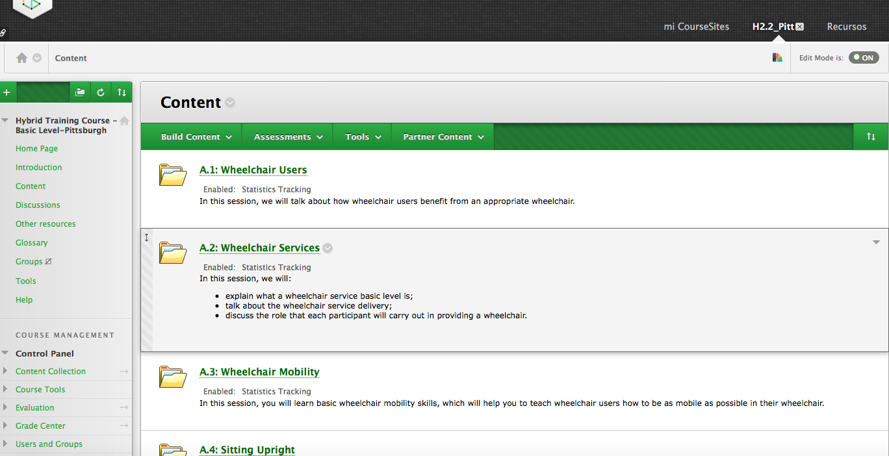
Knowledge Sharing - Resources
Presentations
Online modules
Notes:
screenshots of the modules - into slides - lab sessions
resources - content and
experience sharing, resourcec sharing ppt, online modules

Slide 68
Demographics
Setting | Country | Organization / Training Institution | What is/was piloted?
Low income | Togo | L’Ecole Nationale des Auxiliaires Médicaux (ENAM) | Included the training curriculum wheelchair for basic service training for P&O third year students.
Lower-middle income | Sudan | International Committee of the Red Cross(ICRC) | Pilot WSTP – Basic as a modules for the ongoing CAT II Diploma Course
Lower-middle income | Cambodia | Cambodian PT Association | The WSTP– Basic and Intermediate is integrated into the Bachelor of PT
 | India | Indian Spinal Injuries Centre | In-progress
 | Laos | Faculty of Medical Technology, Vientiane | TBD
Upper-middle income | Thailand | Mahidol University | Tentative plan for national conference about wheelchairs in 2017.
 | Thailand | Chiang Mai University | Training 3rd year students on WSTP – Basic as a part of ADL course for 6-8 hours per semester
Upper-middle income | Brazil | Federal University of São Paulo (UNIFESP) | TBD
 | Colombia | Universidad CES, Medellin | ISWP Basic wheelchair service provision test in Spanish. One faculty received ToT basic training. Basic cushion fabrication session for 5th sem PT students. Creation of Professional study group which meets once a month.
High income | Canada | University of Montreal | Incorporated materials from WSTP – Basic and Intermediate. Also supplementing the WSTP materials with the evidence-based Wheelchair Skills Program. Developing online modules for wheelchair skills testing/training classes
 | Canada | University of Manitoba | Structured exiting and new course material using the WHO 8-step framework. Integrated some of the content/materials from the WHO WSTP Basic and Intermediate packages.
 | USA | University of Hartford | TBD
 | USA | Belmont University | TBD
Notes:
university names

Slide 69
Learnings and Observations
Importance of ISWP support.
Looking forward to the development of the ‘Integration toolkit’.
Knowledge sharing – 4 meetings held until now.
Sharing of course materials

Slide 70
Learnings and Observations
A much needed initiative, for the sake of continuity, continued consultations with ISWP for the wheelchair curriculum.
Importance of ISWP support.
Looking forward to the development of the ‘Integration toolkit’.
Knowledge sharing – 4 meetings held until now.
Sharing of course materials
It has been very importance to us to have ISWP support (basic test, online materials, feedback and experience from other

Slide 71
Learnings and Observations
Importance of ISWP support.
Looking forward to the development of the ‘Integration toolkit’.
Knowledge sharing – 4 meetings held until now.
Sharing of course materials
It is great if ISWP discuss at the High Level meeting and finalize what are the recommended topics for WSTP-b and WSTP-I; including teaching hours, class practical hours and clinical placement hours to integrate to the school of physiotherapy.

Slide 72
Learnings and Observations
Learning from the experiences of others who are integrating is helping.
Importance of ISWP support.
Looking forward to the development of the ‘Integration toolkit’.
Knowledge sharing – 4 meetings held until now.
Sharing of course materials
Participants were encouraged to initiate exchange and ideas during the online meetings

Slide 73
Learnings and Observations
Importance of ISWP support.
Looking forward to the development of the ‘Integration toolkit’.
Knowledge sharing – 4 meetings held until now.
Sharing of course materials
There was a strong focus on encouraging participants share materials (from their courses) on a shared online drive

Slide 74
Case Studies
Universidad CES - Colombia
University of Montreal - Canada

Slide 75
Integration efforts department of physical therapy and school of medicine CES
Participated in ToT training: 1 basic and 1 M/S
Mar
Jul
2017
2016
Basic test last year PT students

Slide 76
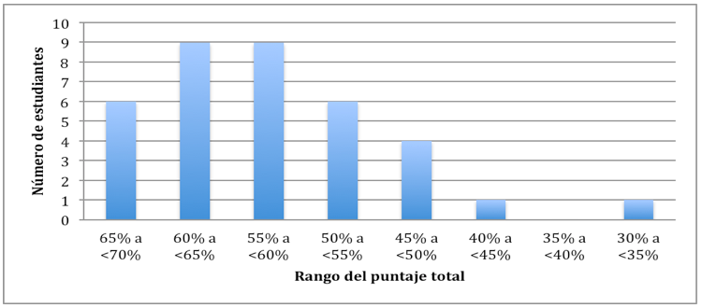
ISWP basic test as diagnostic tool
N=40
38 attended and 36 finished
Average % total score 57,4 ± 7,8 (75% needed to pass)

Slide 77
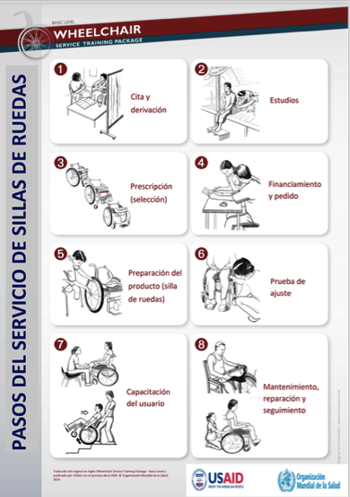
Problematic topics

Slide 78
Integration in CES Dept. of PT & Medicine
Hybrid training with ICRC AND interprofessional ICF and WC
AND Stakeholders meeting
Participated in ToT training: 1 basic and 1 M/S
Interview head of PT undergraduate
Mar
Jul
Sep
Oct
Feb
2017
2016
Basic test last year PT students
Hybrid basic training:
1 PT, 1 Eng, 1 PM&R trainers
2 PT instructors participated
Procured tools and donated WCs
Pilot: ICF and basic WC provision (20 hrs)

Slide 79
2017 National PT Conference ad.

Slide 80
Case Studies
Universidad CES - Colombia
University of Montreal - Canada

Slide 81
Case Study - Montreal
Wheelchair Content in Various Courses - Pre 2016
(mandatory courses)
Content | Delivery
Topics in Gerontology: Positioning | Lecture & Lab (3h)
Mobility and Transfer Laboratory | Lab & Group Discussion (3h) ‘Day in a Manual Wheelchair’
Mobility Aids | Lecture (20 min), Lab (55 min) & Discussion (15 min)
Anthropometric Measures | Lecture (20 min), Case Study (10 min), Lab (45 min) & Discussion (15 min)
Technical Aids: Tilt in Space | Lecture (20 min), Case Study (10 min), Lab (45 min) & Discussion (15 min)
Therapeutic Surfaces, Cushions | Lecture (20 min), Case Study + Lab (50 min) & Case Study Discussion (20 min)
< 12 hours
Notes:
Describe my learning process as part of being part of the ISWP … pilot sites projet

Slide 82
Case Study - Montreal
Ergothérapie et l’utilisation du fauteuil roulant
(optional course)
Content | Delivery | Evaluation
WSTP basic & intermediate packages | 3 credit course (45 hours) 1 class (3-4 hours) per week for 15 weeks Lecture Lab Online modules | Presentations Mid-term Participation Final exam - Written - Practical
Wheelchair Skills Program
Other pertinent assessments (e.g., WheelCon, LSA, WhOM) & interventions (WheelSeeU)
** culturally sensitive
Notes:
Describe my learning process as part of being part of the ISWP … pilot sites projet

Slide 83
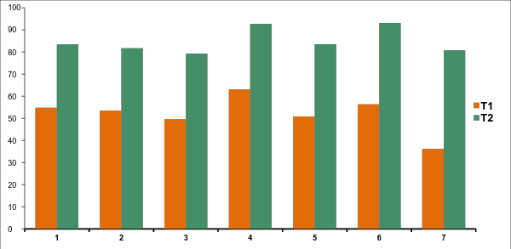
Case Study - Montreal
Pre-Post
Ergothérapie et l’utilisation du fauteuil roulant
Notes:
Describe my learning process as part of being part of the ISWP … pilot sites projet

Slide 84
Student Perspectives (n=31)
‘The model [WHO 8-step Wheelchair Service Provision Process] used for teaching the course aided in comprehension of the material.’
‘We liked having the WHO WSTP materials.’
‘All students should need to take this course.’
‘We suggest having a course earlier (in 2nd year)… an intensive week long course or a full day, so that every student has a base [of wheelchair knowledge].

Slide 85
Meeting Goals
Share outcomes of our research
Share activities related to integration
Learn about steps/ways to amplify integration activities.
Who are key decision makers related to curriculum
Continuing education vs. core curricula
Challenges/Opportunities related to funding & implementation
Joint position paper about integration goals

Slide 86
Accelerating integration activities
Who are key decision makers related to curriculum?
what steps to take for integration?

Slide 87
Decision Makers re Curricula
OT
Promote package through our network (92 national associations), and directly to educational programs (>800) that WFOT approves.
Share survey information related to uptake of WSTP.
WFOT will share case studies to raise awareness through e-newsletter, online.
Endorsement of WSTP/ISWP materials.
Provide online modules through their lms (moodle)
WFOT congress could include this topic (addl symposium).
Online OTION forum related to WC training.
Position statement on AT in their curriculum to clarify that WCs.
Global survey on AT to include WC.
ISPRM
-Endorsement of WHO Materials
-After endorsement– promoting materials at conferences.
Notes:
idenitfy next steps for each organization

Slide 88
Decision Makers re Curricula
WCPT
Already promote wstp on their website.
WCPT only accredits small # of programs (most done by national bodies). About 10 per year. WCPT does have their own standards.
Could more actively promote WSTP.
Will ’support’ WSTP materials.
Survey
O&P (only 40% are O&P trained)
Awareness (ISWP/MOU, promotion at congress) already happening.
ISWP used short-course awareness approach; they have team and could do short course collaboration through their network (so continuing ed)
Makes perfect sense to have as part of curriculum (Carson); all core resources and tools are available.
ISPO to endorse; allows changes to curriculum, but competencies the same.
WC topic is in new guidelines to be published in Capetown.
Continuing education; add to list of short course.
Engage in industry
ToT is critical to build.
Future congress to include leads of all professional organizations to continue discussion.
ISWP?
Develop survey about scope of practice in field for all organizations to reach out. (use WFOT survey?)
Setup consortiums in certain countries (South Africa & Brazil already working together as an example)
WHO
- Work to brand wstp with logos from all endorsing organizations.
Notes:
idenitfy next steps for each organization

Slide 89
Core curriculum vs. Continuing Ed
Trade-offs?
Next steps for each:
Notes:
identify next steps for each organization

Slide 90
Moving Forward
Joint Position Paper describing commitment to WC services training
Standard materials, including eLearning
Advocacy Strategy
Notes:
idenitfy next steps for each organization

Slide 91
Challenges/Opportunities
Notes:
idenitfy next steps for each organization

